Slide 1

Next Generation Science Standards
Rigorous, relevant, Integrated and Just Plain fun!
Presented by:
Mary Cerny
Elementary Science Specialist
Co-Chairman NGSS State Committee
Elementary Science Instructor, USD 305

Slide 2

Notes:
Poll Title: What is your current position?
http://www.polleverywhere.com/free_text_polls/s3h2UDywQX3625W

Slide 3
Notes:
Poll Title: How many years of experience do you have in your current position?
http://www.polleverywhere.com/free_text_polls/FwX3KItVOeOeTYw

Slide 4
Notes:
Poll Title: How familiar are you with the new state standards? (5 is "I could be teaching this session.", 1 is "We have new standards?"
http://www.polleverywhere.com/free_text_polls/yeqntrVDQVKXj3P

Slide 5
Notes:
Poll Title: Which statement best relays your comfort level with the new science standards?
http://www.polleverywhere.com/multiple_choice_polls/ELcs4AWMojqGiBV

Slide 6
Presentation Outcomes:
1. Become aware of your vision for science in your setting.
2. Figure out where you are personally in the process of implementation of the new science standards.
3. Build a stronger understanding of how the standards will look in your setting.
4. Gain more knowledge of what integration means.

Slide 7
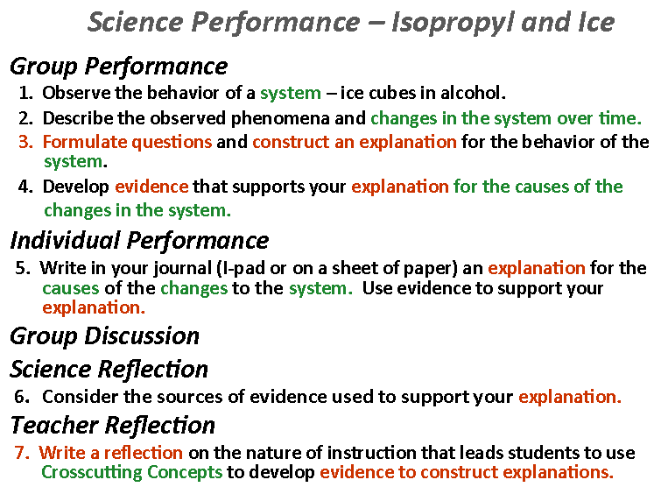
Notes:
Give attendees time (5 min.) to do 1-5 right now.
Discuss what is happening and discuss 6-7 after slide 19.

Slide 8
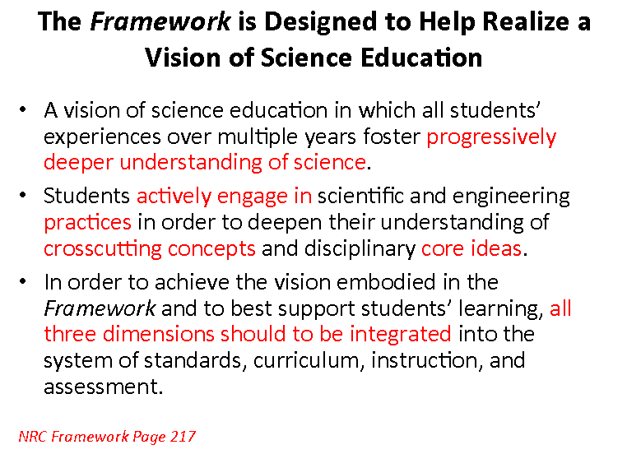

Slide 9

Kansas State’s Vision

Slide 10
Who should be concerned about the standards?
A true science and technology dominated world creates informed citizens in a democracy.
Notes:
From Appendix C:
Sixty percent of U.S. jobs are predicted to require some form of postsecondary education by the end of the decade (Georgetown University Center on Education and the Workforce, 2013).
• The U.S. Department of Labor notes that companies have reported more than three million job openings every month since February 2011 because of an absence of applicants with the skills to fill these positions (Woellert, 2012). The National Science Foundation also reports that there are currently between two and three million unfilled positions in the STEM areas of science, technology, engineering, and mathematics.
• The shortfall in STEM employees is likely to increase. The Department of Commerce shows that in the past 10 years, STEM jobs grew at three times the rate of non-STEM jobs, a trend likely to continue and accelerate (Langdon et al., 2011).
True scientific literacy has historically been reserved for the “gifted” rather than required for everyone. 55% of science and engineering occupations are filled with white men; 18% are white women; Black men and women make up only 3% while Hispanic men and women make up just 4%.

Slide 11

Define Your Vision for Science in your setting.
1. What do you hope that your students learn about science?
2. Why is it important for students to learn about science in this way?
Notes:
(5 minute journal) Have attendees write their answers to this question on the construction paper eyes; in a statement format so they can hang it in a visible spot in their rooms.

Slide 12
How does your vision effect other stakeholders in your community?
Other educators; pre-K through post-secondary
Other buildings in your district
Other KS districts
Parents
Business and industry
Museums, zoos, other informal educators
Notes:
Write notes to other stakeholders on “stickies” around the Vision statement eye.

Slide 13

Stages of concern about new science standards:
Stage 0-Awareness
  Not really interested
  “Golly, I don’t know
  any of this.”
Notes:
Wouldn’t be here if you were at this stage.

Slide 14

Stage 1-Information
Where can I get more information about this?
“I’ve got to learn and
read more!”

Slide 15
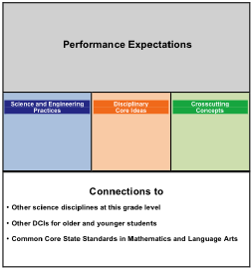
How do I read the new standards?
Performance Expectations
Practices
Disciplinary Core Ideas
Crosscutting Concepts
Connections
Notes:
Crosswalking old standards with new standards is useless. New standards are too different.
Current performance on old standards is the baseline to use for the shift.

Slide 16
Shift 1:
1. Real-world connected.
Notes:
Understanding the overall shifts and the challenging implications they will have to your program are essential.
The most difficult shifts will probably be the most beneficial for your students.
The nature of science is taught as it is experienced in the real world. This means applying the core ideas and using them to understand science via the patterns and practices that are witnessed in the real world.

Slide 17
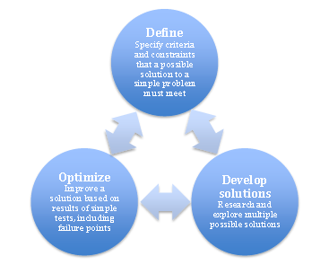
Shift 2:
2. Students learn facts by doing and demonstrating engineering and science in all contexts.
Notes:
Not facts but doing scientific practices and demonstrating the application of concepts and ideas in any context.
Practices and crosscutting concepts are used to teach core ideas all year every year.
Appendix I

Slide 18
8 Science and Engineering Practices
1. Asking questions (for science) and defining problems (for engineering)
2. Developing and using models
3. Planning and carrying out investigations
4. Analyzing and interpreting data
5. Using mathematics and computational thinking
6. Constructing explanations (for science) and designing solutions (for engineering)
7. Engaging in argument from evidence
8. Obtaining, evaluating, and communicating information
Notes:
Appendix F

Slide 19
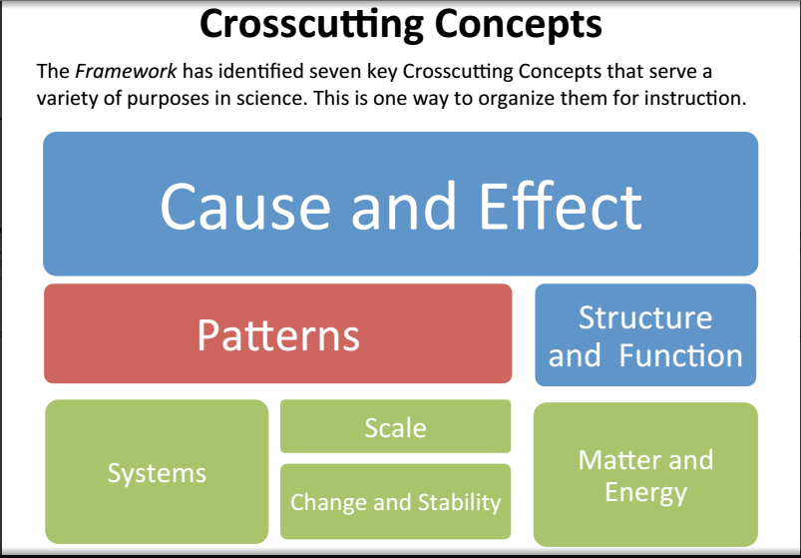

Slide 20
Notes:
Discuss 6-7 after slide 19.

Slide 21
Shift 3:
Disciplinary Core Ideas built coherently across K-12.
Notes:
Appendix E- DCI Progressions

Slide 22
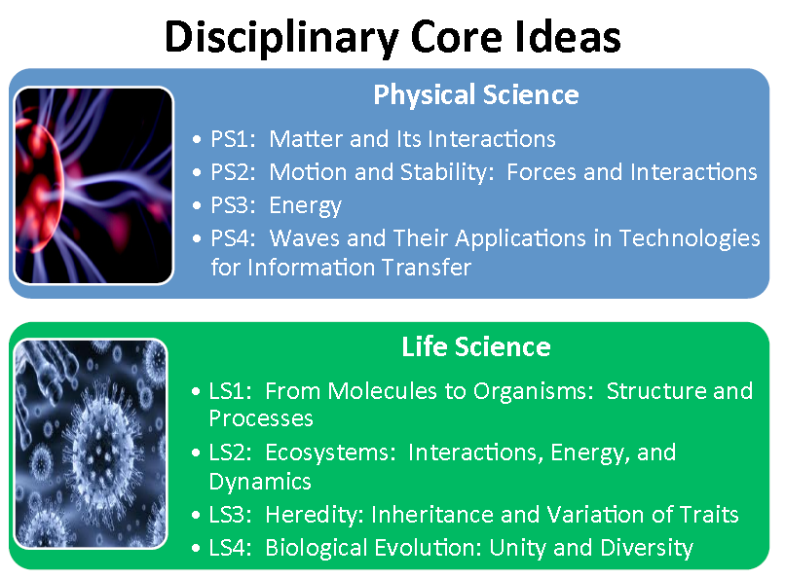

Slide 23
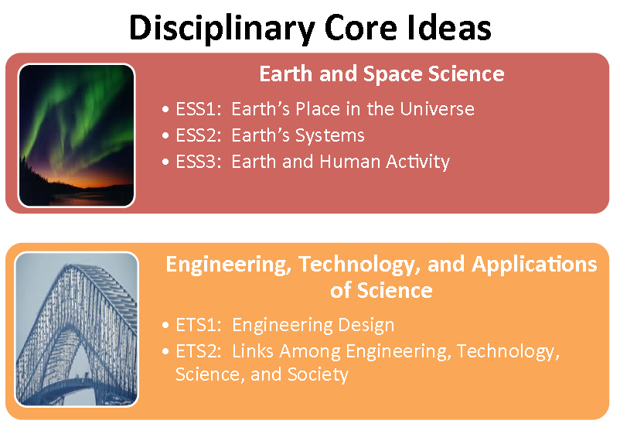

Slide 24

Shift 4:
Deeper understanding through application of content.
Notes:
Problem/Project Based Instruction; Modeling Instruction;

Slide 25




Shift 5:
Written for integration.
Notes:
Integrates with math, ELA KSCCRSS.
Math-Appendix L (Chart of first expected mastery of Math in CCSS).
ELA- Appendix M

Slide 26
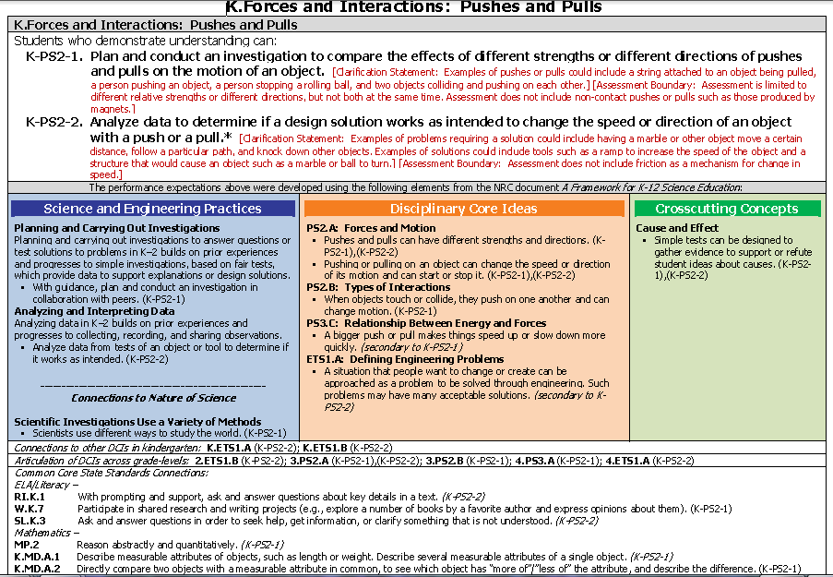
Notes:
Science Standards: Nextgenscience.org

Slide 27

Shift 6:
Performance Expectations not curriculum.
  Expect mastery at each grade level so new performance expectations can be mastered at next level.
Notes:
Curriculum (TBD) is a district decision based on the educational vision for the students in that community.
Standards (2013) are a state decision based on the educational vision for the students of that state.
National Frameworks (2011) are written and endorsed at a National level based on the educational vision for the students of that Nation.
Many times the hierarchy is forgotten.

Slide 28

Shift 7:
A solid K-12 Science Education prepares our students for college, careers and citizenship.
  Complex World requires science knowledge to make sense of it all.
Notes:
science and science education are necessary for all Americans.
current events, choosing and using technology, or making informed decisions about one’s healthcare,
Science is also at the heart of the United States’ ability to continue to innovate, lead, and create the jobs of the future.

Slide 29
Back to your Vision
Why and how are the standards essential to your vision of success in your setting?
How do the standards support your vision of science education in Kansas?
Notes:
(5 minute journal) Add the response on your Vision sheet.
Why and how are the standards essential to your vision of success in your classroom goals?
How do the standards support your vision of science education in KS?

Slide 30

Stage 2-Personal
This is going to be a lot of work!
“I’m scared to death and
need to get out.”

Slide 31
Change is the law of life. And
those who look only to the past
Or present are certain to miss
the future.
John F. Kennedy

Slide 32
What do these standards look like in the classroom?
Every lesson will consist of three components which utilize science and engineering practices:
  Gathering
  Reasoning
  Communicating
Notes:
Gathering-
Science & Engineering Practices:
Asking questions (for science) and defining problems (for engineering), Developing and using models, Planning and carrying out investigations, Using mathematics and computational thinking, Obtain information
Reasoning-
Science & Engineering Practices:
Analyzing and interpreting data, Using mathematics and computational thinking, Evaluate information, Constructing explanations (for science) and designing solutions (for engineering)/:Solving Problems
Communicating-
Science & Engineering Practices:
Engaging in argument from evidence, Use models to predict & develop evidence, communicating information, Use argue from evidence (written or orally), Use models to communicate

Slide 33
Reasoning
Communicating
Gathering
Obtain Information
Ask Questions/Define Problems
Plan & Carry Out Investigations
Use Models to Gather Data
Use Mathematics & Computational Thinking
Evaluate Information
Analyze Data
Use Mathematics and Computational Thinking
Construct Explanations/Solve Problems
Developing Arguments from Evidence
Use Models to Predict & Develop Evidence
Communicate Information
Argue from Evidence (written & oral)
Use Models to Communicate
Notes:
Science and Engineering Practices.

Slide 34
What do these standards look like in the classroom?
Every lesson will use as many crosscutting concepts as useful for the type of task.
  Causality
  Systems
  Patterns
Notes:
1. Patterns-
2. Causality-Cause and effect; Structure and function.
3. Systems-Scale, proportion, and quantity; Systems and system models; Energy and matter: Flows, cycles, and conservation; Stability and change.
1. Patterns. Observed patterns of forms and events guide organization and classification, and they prompt questions about relationships and the factors that influence them.
2. Cause and effect: Mechanism and explanation. Events have causes, sometimes simple, sometimes multifaceted. A major activity of science is investigating and explaining causal relationships and the mechanisms by which they are mediated. Such mechanisms can then be tested across given contexts and used to predict and explain events in new contexts.
3. Scale, proportion, and quantity. In considering phenomena, it is critical to recognize what is relevant at different measures of size, time, and energy and to recognize how changes in scale, proportion, or quantity affect a system’s structure or performance.
4. Systems and system models. Defining the system under study—specifying its boundaries and making explicit a model of that system—provides tools for understanding and testing ideas that are applicable throughout science and engineering.
5. Energy and matter: Flows, cycles, and conservation. Tracking fluxes of energy and matter into, out of, and within systems helps one understand the systems’ possibilities and limitations.
6. Structure and function. The way in which an object or living thing is shaped and its substructure determine many of its properties and functions.
7. Stability and change. For natural and built systems alike, conditions of stability and determinants of rates of change or evolution of a system are critical elements of study.

Slide 35
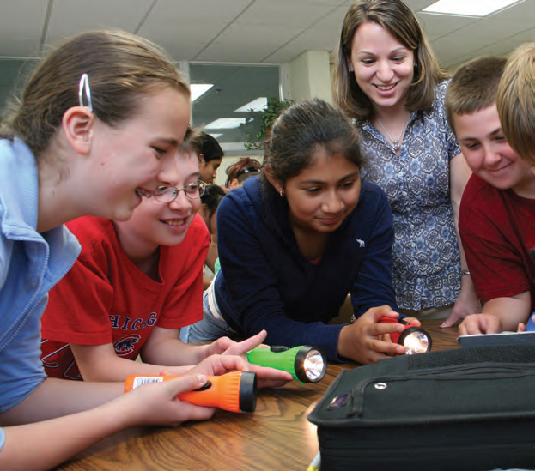
Science and Engineering Practices
  Performance: Explanations Using Evidence
Notes:
This is a discussion of how we know in science. It can be the air idea that combines the core idea and investigational evidence.
The student is at the heart of instruction.

Slide 36
Collaborate to Solve Problems
Gather Information
Design Solutions
Test Solutions
Re-design
Determine Limitations

Slide 37
Similarities and Differences
Scientific Inquiry | Engineering Design
Ask a question | Define a problem
Obtain, evaluate, and communicate technical information | Obtain, evaluate, and communicate technical information
Plan investigations | Plan designs and tests
Develop and use models | Develop and use models
Design and conduct tests of experiments or models | Design and conduct tests of prototypes or models
Analyze and interpret data | Analyze and interpret data
Use mathematics and computational thinking | Use mathematics and computational thinking
Construct explanations using evidence | Design solutions using evidence
Engage in argument using evidence | Engage in argument using evidence
Adapted from A Framework for K-12 Science Education (NRC, 2011)
Notes:
When we compare these practices there are clear places where engineering differs from science, but across all the outcome build upon one another.

Slide 38
Performance: Developing Models to Support Explanations
Group Performance
Investigate how an airplane (glider) flies.
Individually Explore Solutions: Using a sheet of copy paper, design and build a paper airplane capable of flying a horizontal distance of 2X meters when you drop it from a height of X meters. You cannot throw the plane, only drop it.
In groups of three: Collaborate to solve the problem of flying a glider two times as far as the height from which it is dropped.
Formulate questions and investigate explanations for how the airplane flies.
Develop a model to show the forces on the airplane.
Develop evidence to support your explanations.
Write the steps of the engineering design process your group followed.
Individual Performance
Write in your journal, or on note paper, your explanation that may be used to explain this phenomena to others. Include evidence to support your explanation for how the airplane is able to fly and develop a model to communicate your explanation.
Group Discussion
Reflection
Reflect on the nature of science instruction that helps students to develop explanations based upon evidence and the role of the science and engineering practices for engaging students in gathering, reasoning, and communicating science ideas.
Notes:
Engage in a discussion after the participants have had a change to gather evidence to construct an explanation.

Slide 39
Performance: Developing Models to Support Explanations
Group Performance
Investigate how paper floats.
Individually Explore Solutions: Using a sheet of copy paper maximize the float time (time it takes to fall to the ground).
In Groups of Three: Collaborate to solve the problem of float time.
Formulate questions and investigate explanations for how the paper floats.
Develop a model to show the forces on the paper.
Develop evidence to support your explanations.
Individual Performance
Write in your journal, or on note paper, your explanation that may be used to explain this phenomena to others. Include evidence to support your explanation for how the paper floats slowly to the ground and develop a model to communicate your explanation.
Group Discussion
Reflection
Reflect on the Core ideas that help you make sense of how to maximize float time.
Notes:
Engage is a discussion after the participants have had a change to gather evidence to construct an explanation.

Slide 40
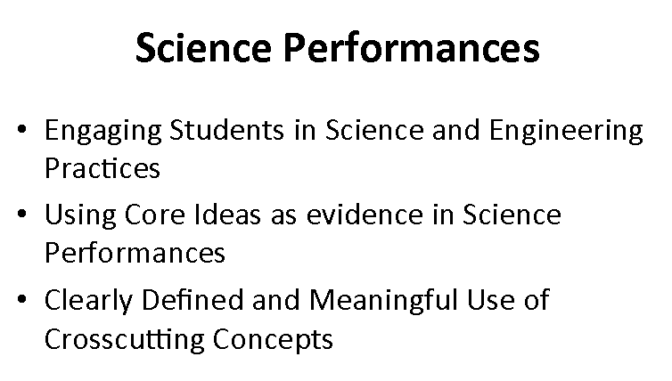

Slide 41

Stage 3-Management
I just don’t have the time to get this all done.
“This is awful.”

Slide 42
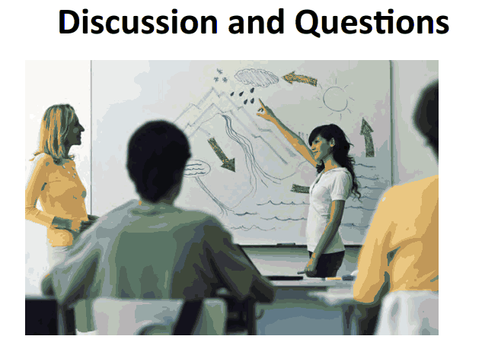
Notes:
Focus on three levels of student participation: Gathering, Reasoning and communicating.

Slide 43

How soon are we supposed to be implemented?
Notes:
Old Test this year (2014),
None next year (2015)
5th grade, 8th grade and Sophmore/Junior in 2016.
State Implementation timeline-Take time and implement soundly. Expecting it to be a cyclic process that will still be rolling when standards are ready for review again in 7 years.

Slide 44
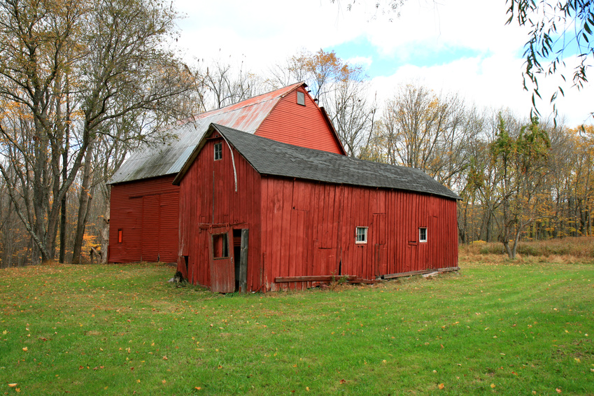
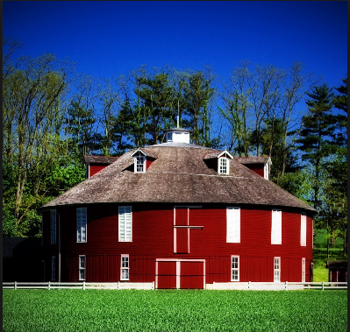

How do we know when we have accomplished implementation?
Notes:
You have to know where you have been, to know where you are going.
Set Goals for Science in context with your overall context of all educational goals.

Slide 45
Potential Measures of science Performance:
Formatives
Graduation rate
STEM related careers/jobs
State exams tracking same students
???
Notes:
Formatives-developed to measure how your teaching is going and where changes need to be with your eye on your goal.
District created; won’t be created like old test formatives.
High School graduates
post high school careers/jobs in STEM fields
State exams

Slide 46
How can we prepare our students to be successful on the unknown assessment?
Mastery of performance expectations
Mastery of engineering practices
Mastery of crosscutting concepts
Application of learned material
Notes:
Mastery of performance expectations at all grade levels
Mastery of all engineering practices and crosscutting concepts
Practice applying learned material to all areas of student’s day. Don’t turn it on for Science class.
The cycle of hypothesis and analyzing data will prepare them.

Slide 47
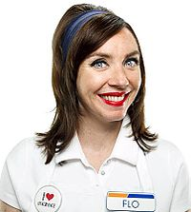
Stage 4-Consequence
I would like to excite my colleagues/students about their part in this program.
“How Can I help?”

Slide 48
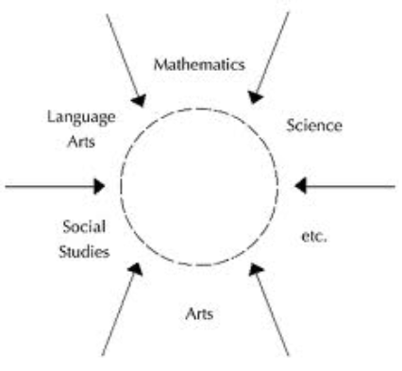
How can we fit Science into the day?
Integration

Slide 49

Notes:
Student led lessons mean more teacher prep up front.

Slide 50

Stage 5-Collaboration
We need to coordinate our delivery better, share ideas and
“team” it.
Notes:
Collaborative planning times, PLC’s, internet opportunities, social media, organizations
Involved in professional development activities and concerned about the effect of the standards on their students.

Slide 51
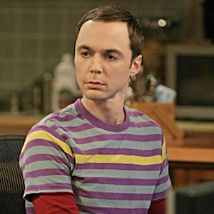
Stage 6-Refocusing
“I know everything there is to know.”
Notes:
You might be ready to move on to something new.
I know of some other approaches and am interested in looking at alternatives to our current system.

Slide 52
Resources:
Sign journal with your google email.
Standards document-Nextgenscience.org
KSDE-community.ksde.org
  KSDE Science Apps page
  KSDE Summer Academies
District Implementation Plan
Kansas Association of Teachers of Science-KATS.org
National Science Teachers Association-NSTA.org
Learning Forward-Learningforwardkansas.org
Notes:
google doc “Too Many Standards”

Slide 53
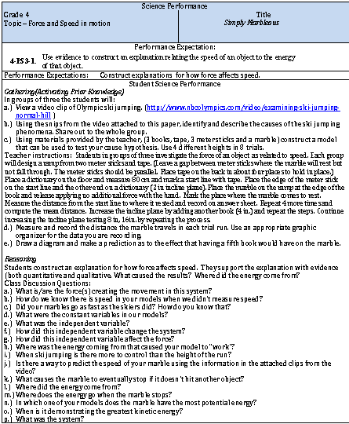
Example of a lesson written for the New Science Standards

Slide 54
Mary Cerny
marycerny77@gmail.com

