Slide 1
Strategies to Get
the New Standards
for Professional Learning
Into Practice
LF KS Annual Leadership Conference
April 9, 2014
Sandee Crowther & Sheri Thomas

Slide 2
Let’s Get
Started . . .
Introductions
and
Learning Objectives
The Learner will be able to . . .
Understand the purpose and key components of the revised Standards for Professional Learning.
Assess what are the educator practices in your school or district related to professional learning.
See the Standards in action in a school setting.

Slide 4
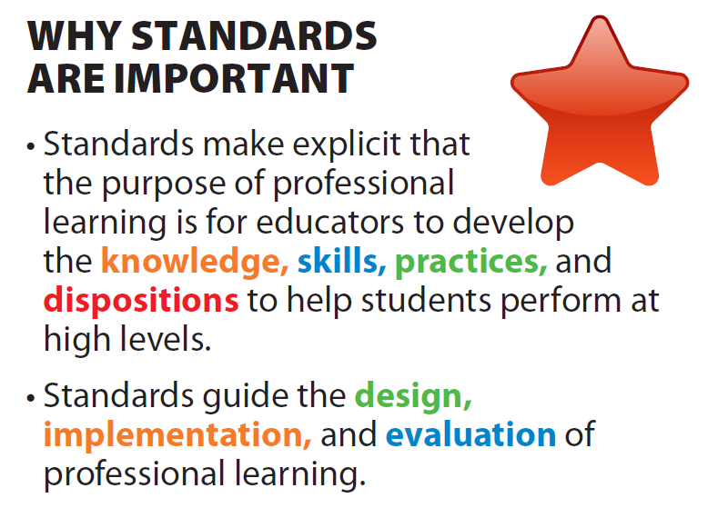

Slide 6
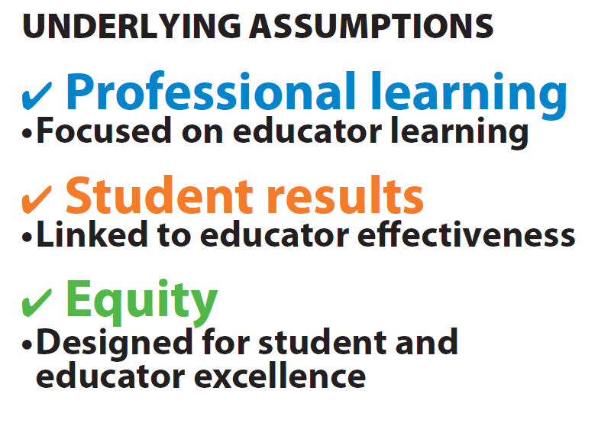

Slide 7
Assess Educator Practice in Your Setting
Refer to the document “More of This and Less of That: How Do You Score?”
Read the document silently.
Refer to the scoring system under the chart to score yourself in each of the five categories.
Discuss your results with a partner.

Slide 8
Organization
Fewer Standards
Holistic View
Combined Content Standard
Revised Stem
3 Focus Areas
8
Notes:
Fewer standards: Seven standards emerged from the study of research literature about professional learning. They were included in earlier editions of the standards, and are now more clearly defined, and some aspects are more prominent.
Holistic view: The standards work in partnership with one another. Focusing on some rather than all standards may contribute to the failure of professional learning to deliver on its promised results.
Combined content standard: The Outcomes standard that incorporates two dimensions, student learning outcomes and educator performance expectations.
Revised stem: This stem confirms the link between educator practice and results for students, and also emphasizes equity of results. The use of “all” is intentional to elevate the significance of ensuring the success of every student.
Three areas of focus: The Standards for Professional Learning describe the context, processes, and content for effective professional learning. Learning Communities, Leadership, and Resources standards define the essential conditions for effective professional learning. Data, Learning Designs, and Implementation standards describe the attributes of educator learning processes that define quality and effectiveness of professional learning. The single content standard, Outcomes, identifies the essential content of professional learning.

Slide 10
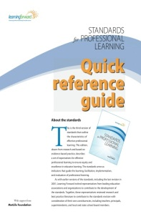
Quick Reference Guide Layout
About the Standards
STEM: Professional learning that increases educator effectiveness and results for all students . . .
Seven Standards
Four Pre-requisites
Relationship between professional learning and student results
Suggestions for Use
Notes:
Handout – a Scavenger Hunt –our HO 3.1

Slide 11
Notes:
Reference pages . 12 – 20 and 62-63 of Standards for Professional Learning, Learning Forward Publication
Professional Learning Unit 4 – Standards for Professional Learning p. 12 – 31 –see link in resource slide.

Slide 12
Standards Overview
Individually read your assigned standard, (Handout 4.1) including the introduction and elaboration.
Use Handout 4.2 to organize your notes.
As a team, discuss the key points and your insights about this standard.

Slide 13
Standards Windowpane Template
Key Points What information or ideas are important to know about this standard? | Standards in Practice Which behaviors are observable when this standard is fully implemented?
Symbol What visual representation would help people remember this standard? | Next Steps What steps are necessary to implement this standard?

Slide 14
Standards Showcase
Collectively determine how your group will showcase your standard in a three minute presentation using Handout 4.2.
Use Handout 4.3 to collect key points on each standard during the showcase.
Be prepared to debrief with the whole group following the showcase.
Notes:
Chart paper for group to use to showcase. Sharing window-pane – 3 minute time limit

Slide 15
Standards for Professional Learning – Self Assessment
As you finish on your group’s standard report ...
Review the self-assessment (Handout 6.1) to rate how your current professional learning aligns with the Standards of Professional Learning.

Slide 16
Video: http://bit.ly/RSIzKz
Quil Ceda & Tulalip Elementary
Marysville School District
Tulalip, Washington
Handout:
Standards in Action –Video Quil Ceda & Tulalip
Questions 1 - 6
Notes:
Use Standards for Professional Learning Fact Sheet 2013 – 14 –(KSDE and LF KS) whatever the current version is as of April 2014

Slide 17
Internet
Resources
Quil Ceda Video: http://bit.ly/RSIzKz
LF Professional Learning Units: http://bit.ly/16NJ7vK
(Please note the longer descriptions of the PL Standards are found in Unit 4: Standards for Professional Learning.)

Slide 18
What actions will you take to improve professional learning in your school or district?
Closing and Evaluation

Slide 19
Contact information:
Sandee Crowther
Executive Director, Learning Forward Kansas
crowther.sandra@gmail.com
Sheri Thomas
Past President 2013 -14, Learning Forward Kansas
Middle School Math Teacher
McLouth USD 342
sdthomas47@hotmail.com

