Slide 1
The Importance of Professional Learning in Systems Reform
AdvancED Performance Accreditation
Bev Mortimer
Concordia Superintendent
bmortimer@usd333.com
Rick Kraus
Hutchinson Asst. Supt
krausr@usd308.com
Dr. Nancy Bolz
AdvancED Kansas Director
nbolz@advanc-ed.org
Notes:
Notes: This presentation provides information for various educational institutions. If you need a presentation for a specific type of institution (e.g. schools, systems, corporations, digital learning), simply hide the slides and omit the information that is in the notes that would not apply.

Slide 2
Session Description
Professional learning is a key component to changing and operating any system! Come hear how the AdvancED framework incorporates it into their continuous improvement model that leads to district/system accreditation and discuss how the process can be incorporated in your district.
Strand: PL Interactive
Notes:
Notes:
Goals for the training:
Understand the relationship between continuous improvement and accreditation
Gain awareness of the AdvancED Protocol
Explore how to use diagnostic tools for meaningful self-assessment and continuous improvement
Understand the AdvancED External Review process as the foundation for continuous improvement
Provide participants with the training survey link:
https://www.surveymonkey.com/s/CI_Schools_Systems
This link is also positioned on the last slide of this slide deck.

Slide 3
Goals
Understand the relationship between continuous improvement and professional learning
Gain awareness of the AdvancED systems protocol
Gain awareness of this journey for Concordia and Hutchinson
Discuss how that applies to your district
Notes:
Notes:
Goals for the training:
Understand the relationship between continuous improvement and accreditation
Gain awareness of the AdvancED Protocol
Explore how to use diagnostic tools for meaningful self-assessment and continuous improvement
Understand the AdvancED External Review process as the foundation for continuous improvement
Provide participants with the training survey link:
https://www.surveymonkey.com/s/CI_Schools_Systems
This link is also positioned on the last slide of this slide deck.

Slide 4
Learning Design
Present information about our district level process
Hear about the journey for Concordia and Hutchinson
Discuss how that applies to your district
Notes:
Notes:
Goals for the training:
Understand the relationship between continuous improvement and accreditation
Gain awareness of the AdvancED Protocol
Explore how to use diagnostic tools for meaningful self-assessment and continuous improvement
Understand the AdvancED External Review process as the foundation for continuous improvement
Provide participants with the training survey link:
https://www.surveymonkey.com/s/CI_Schools_Systems
This link is also positioned on the last slide of this slide deck.

Slide 5
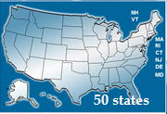
Our work across the globe has provided job imbedded professional learning opportunities for our staff
Notes:
Notes: Who is AdvancED? An international, global organization servicing educational institutions in the 50 United States, Puerto Rico, Navajo Nation, 72 countries and Department of Defense around the world. As the largest educational community, we serve more than 20 million students, 3 million teachers, and 32,000 public and private institutions. AdvancED provides services to these educational institutions through its staff of 200+ and more than 18,000 volunteers.
<animation for each picture>

Slide 6
How did/do your districts tap into that network for professional learning opportunities?
Discuss: What levels of professional learning exist in your district? What is your network? In what ways is it authentic?

Slide 7
Continuous Improvement
Making the Most of the
Continuous Improvement Process
The Power of Internal Review (Reflections)
Happens at the building level first and/or in tandem.
The district uses that data to determine their ratings.
The Power of External Review (Future Focus)
Only one review at the district level
Review includes building visits, primarily for classroom observations
Notes:
Notes: Encourage participants to make the most of the two components of the performance accreditation process, the internal and external reviews.
Both reviews are designed to provide the institution with the tools and information necessary for their educational institution to remain future focused and moving forward.
The Internal Review provides the educational institution’s stakeholders with the opportunity to gather data/information, reflect on its impact, analyze results, celebrate achievements and identify improvement needs.
The External Review with its focus on moving the institution forward into its future provides guidance and direction on areas identified as improvement priorities and opportunities for improvement.
The AdvancED Performance Accreditation process requires a commitment to continuous improvement. It offers the tools and resources that support and facilitate the institution’s efforts to move forward into their future.

Slide 8
Internal Review
The power of an Internal Review comes from its ability to provide a framework for rich dialogue and collaborative reflection for the purpose of increasing student learning at both the building and district levels.
Notes:
Notes: Encourage the participants to make the most of their continuous improvement process. The internal review has the ability to engage stakeholders in a reflective and collaborative process, that increases their knowledge, sense of ownership, and contributes to the institution’s efforts to ensure student success.
Examines organizational effectiveness
Analyzes student performance
Engages stakeholders in deliberate reflection
Promotes deep and collective understanding of practices, processes and impact
Involves stakeholders in the continuous improvement of the system and its schools
Provides a framework for rich dialogue and important discussion
Produces valid evidence to inform and guide action
Positions institutions to strategically improve
Provides context and information to the External Review Team

Slide 9
Internal Review
Stakeholder Feedback Diagnostic
Assurances
Improvement Plan
Student Performance Diagnostic
Self Assessment
Executive
Summary
Notes:
Notes: Internal Review: Is like looking in a mirror. It is an opportunity for ongoing reflection and analysis of an institution by stakeholders. AdvancED requirements and tools are designed to make this internal diagnosis meaningful and relevant. Stakeholders will gain deep awareness about their institution and this will help inform actions to improve their organization and increase student learning. Internal Review is a comprehensive and continuous process. (It goes well beyond filling out a document.)
This slide illustrates the 6 elements of the Internal Review process.
Executive Summary - General overview, context of institution
Self Assessment - Thoughtful and deliberate reflection of current status
Assurance - Policy and procedure statements. May upload documents to Assurances
Student Performance
Analysis of results over time
Reflects status and improvement
Stakeholder Performance
Analysis of feedback from stakeholders
Improvement Plan(s)
Alignment of improvement goals with diagnostic results

Slide 10
Executive Summary
“Telling the Story”
Define the institution’s purpose and direction
Describe the context of your institution ... location, demographics, brief history of changes, etc.
Identify achievements, accomplishments and challenges
Notes:
Notes: Provide the participants with an opportunity to share their institution’s purpose and direction with each other.
Share their responses to the other items as cited.

Slide 11
The Standards
The Standards include:
Statements (5)
Indicators (33 +)
Focus of internal review
Rated individually
Contain multiple concepts
Quality Evidence (multiple sources)
Performance Rubrics
Four levels
Notes:
Notes: The five AdvancED Standards are comprehensive statements of quality practices and conditions that research and best practice indicate are necessary for schools to achieve quality student performance results and organizational effectiveness.
Accompanying each standard are indicators. The indicators are operational definitions or descriptions of exemplary practices and processes. When seen together, the indicators provide a comprehensive picture of each standard.
What does this tell us? The 33 (+) or more indicators will be rated individually on a 1-4 scale (four descriptive levels) that detail varying degrees of performance. The performance levels contain rich, detailed descriptors of what this indicator looks like in practice.
Evidence identifies the practices and/or processes being implemented that demonstrate the degree to which the school is meeting the indicator. It supports (provides proof) the claim made and answers the how do we know we are doing what we say.

Slide 12
Student Performance
Understand selection, use, analysis of assessments
Collect, analyze and report
Understand the Student Performance Diagnostic requirements
Review Student Performance Evaluative Criteria
Complete Student Performance Diagnostic questions
Notes:
Notes: Goals for this part of the training.

Slide 13
Stakeholder Feedback
Administer Surveys
Complete Stakeholder Feedback Diagnostic
Utilize Results
Analyze Results
Students
Parents
Staff
Students
Parents
Staff
Stakeholder Feedback Data Document
Evaluative Criteria
Diagnostic Questions
Continuous Improvement
With a focus on institutional improvement
Notes:
Notes:
Four Main Steps to the use of the AdvancED Stakeholder Surveys and Feedback Diagnostic:
(There are 4 dissolve-in animations.)
The use of surveys and completion of the Stakeholder Feedback Diagnostic provides an overview of stakeholders’ perceptions regarding an institution.
Surveys that are aligned with the AdvancED Standards are deployed, responses gathered and results analyzed. Careful consideration of the results contributes to an institution’s continuous improvement planning.
Surveys are completed electronically (English) or on paper (variety of languages). Electronically completed surveys have a 24 hour turn-around. Hard copies take generally three weeks to process.
There are four main steps to completing the Stakeholder Feedback Diagnostic:
Administer the surveys to designated stakeholder populations.
Gather and analyze survey results (from various stakeholder groups)
Complete Diagnostic: Formulate the Stakeholder Feedback Data Document
Apply the Evaluative Criteria
Respond to Diagnostic Questions
Utilize survey results in your continuous improvement planning.

Slide 14
Improvement Plan
A quality Improvement / Strategic Plan includes:
Self Assessment
Student Performance
Stakeholder Feedback
Notes:
Notes: Based on the stakeholders’ reflections and informed decisions resulting from the institution’s self-assessment, analysis of student performance and stakeholder feedback results, the institution identifies its improvement priorities and plans on how to address them.
Provisions for monitoring the implementation of their improvement efforts and assessing their impact are incorporated into the plan.
The implementation of a quality improvement plan contributes to the institution’s ability to move forward into its future.

Slide 15
Internal Review
What process did you use to facilitate your Internal Review? At the building level? At the district level?
Discuss:
How do you currently imbed these processes into your continuous improvement efforts? How might you make them more authentic and systemic?
Notes:
Notes: Encourage the participants to make the most of their continuous improvement process. The internal review has the ability to engage stakeholders in a reflective and collaborative process, that increases their knowledge, sense of ownership, and contributes to the institution’s efforts to ensure student success.
Examines organizational effectiveness
Analyzes student performance
Engages stakeholders in deliberate reflection
Promotes deep and collective understanding of practices, processes and impact
Involves stakeholders in the continuous improvement of the system and its schools
Provides a framework for rich dialogue and important discussion
Produces valid evidence to inform and guide action
Positions institutions to strategically improve
Provides context and information to the External Review Team

Slide 16
External Review
The External Review “energizes and equips the institution’s leadership and stakeholders to achieve higher levels of performance and address those areas that may be hindering efforts to reach desired performance levels.”
-Introduction to Exit Report
Notes:
Notes: The External Review has the focus of moving an institution forward into its future. It has the power to energize an institution’s leadership and stakeholders to aspire to and achieve higher levels of performance. Recognizing and addressing improvement priorities can serve as a roadmap for success.

Slide 17
External Review
An emphasis on …
Standard Indicators
Classroom observations (eleot™)
Evaluation of quality evidence
Team dialogue and discussions
Performance level ratings
Actions
Notes:
Notes: The activities of the External Review Team will focus on the assessment of the Standard Indicators, their classroom observations which concentrate on the learner and the learning environment, an assessment of the relevance and quality of the evidence gained through observations, interviews, and review of documents, and their discussions and deliberations.

Slide 18
Classroom Observation
Effective Learning Environments Observation Tool™ (eleot™)
Focuses on observed student behaviors
Looks at patterns and trends, not individual classrooms
Used as one piece of evidence
Reported in Exit Report and External Review Report (only environment averages)
Notes:
eleot™ focuses on student engagement not on what the teacher is doing.
Focuses on observed student behaviors
Looks at patterns and trends, not individual classrooms
Used as one piece of evidence (to corroborate other evidence regarding learning)
Only the seven environment averages are reported in the Exit Report and the External Review Report

Slide 19
The eleot™
Learning Environments
Equitable Learning
High Expectations
Supportive Learning
Active Learning
Progress Monitoring and Feedback
Well-Managed Learning
Digital Learning
Notes:
Notes: The Effective Learning Environments Observation Tool (eleot™) is a state-of-the-art, learner-centric observation instrument, that quantifies students’ engagement, attitudes and dispositions organized in 7 environments: Equitable Learning, High Expectations, Supportive Learning, Active Learning, Progress Monitoring and Feedback, Well-Managed Learning, and Digital Learning. All evaluators are trained, reached acceptable levels of inter-rater reliability, and certified to use this research-based and validated instrument.

Slide 20
Software
Notes:
Notes:
Screen captures of the Executive Summary in ASSIST

Slide 21
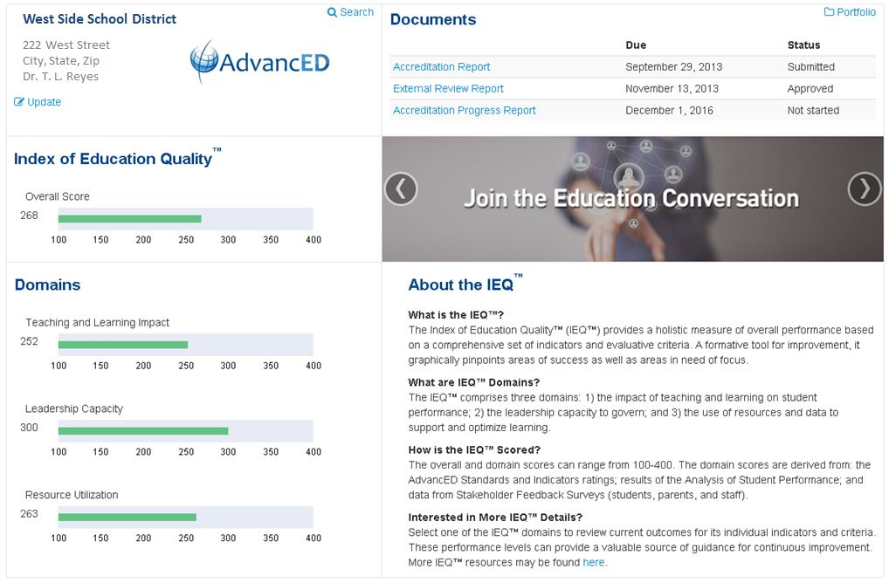
IEQ
Notes:
The three domains of performance are derived from the AdvancED Standards and Indicators; the Analysis of Student Performance; and the Engagement and Involvement of Stakeholders. Within each domain institutions will be able to connect to the individual performance levels that are applied in support of the AdvancED Standards and evaluative criteria. Within the performance levels are detailed descriptors that can be a valuable source of guidance for continuous improvement. Upon review of the findings in this report, institutional leaders should work with their staff to review and understand the evidence and rationale for each Required Action as well as the corresponding pathway to improvement described in the performance levels of the selected Indicator.
The IEQ provides a new framework that recognizes and supports the journey of continuous improvement. Your institution's IEQ is the starting point for continuous improvement. Your actions for improvement that have a positive impact will be reflected in your IEQ score.
IEQ Institutional Score:
Teaching and Learning Impact:
(Standards 3 and 5; Student Performance Criteria)
Leadership Capacity:
(Standards 1 and 2; Stakeholder Engagement Criteria)
Resource Utilization:
(Standard 4)

Slide 22
External Review
What benefits did you see from the External Review Process?
What impact did it have on faculty and staff?
Notes:
Notes: Encourage the participants to make the most of their continuous improvement process. The internal review has the ability to engage stakeholders in a reflective and collaborative process, that increases their knowledge, sense of ownership, and contributes to the institution’s efforts to ensure student success.
Examines organizational effectiveness
Analyzes student performance
Engages stakeholders in deliberate reflection
Promotes deep and collective understanding of practices, processes and impact
Involves stakeholders in the continuous improvement of the system and its schools
Provides a framework for rich dialogue and important discussion
Produces valid evidence to inform and guide action
Positions institutions to strategically improve
Provides context and information to the External Review Team

Slide 23
External Review
Discuss:
How can your leadership ensure conversations about accreditation are authentic and impact student performance?
What data would you need?
What resources would you need?
Could your accreditation process lead you into your strategic planning process?
Notes:
Notes: Encourage the participants to make the most of their continuous improvement process. The internal review has the ability to engage stakeholders in a reflective and collaborative process, that increases their knowledge, sense of ownership, and contributes to the institution’s efforts to ensure student success.
Examines organizational effectiveness
Analyzes student performance
Engages stakeholders in deliberate reflection
Promotes deep and collective understanding of practices, processes and impact
Involves stakeholders in the continuous improvement of the system and its schools
Provides a framework for rich dialogue and important discussion
Produces valid evidence to inform and guide action
Positions institutions to strategically improve
Provides context and information to the External Review Team

Slide 24
PL Standards
AdvancED provides a “Learning Community” certification for Learning Forward’s Professional Learning Standards for any school or district that wants to include them in their process.

Slide 25
PL Standards
Did we incorporate…
Learning Communities
Leadership
Resources
Data
Learning Design
Implementation
Outcomes

Slide 26
Create a World of Opportunities for Every Learner

Slide 27
Find Us
Please complete the training survey:https://www.surveymonkey.com/s/CI_Schools_Systems
www.advanc-ed.org
Notes:
Notes:
Have participants complete training survey at the end of this training.
https://www.surveymonkey.com/s/CI_Schools_Systems

